Slide 1

CROSSROAD
KANSAS | MISSOURI

Slide 2
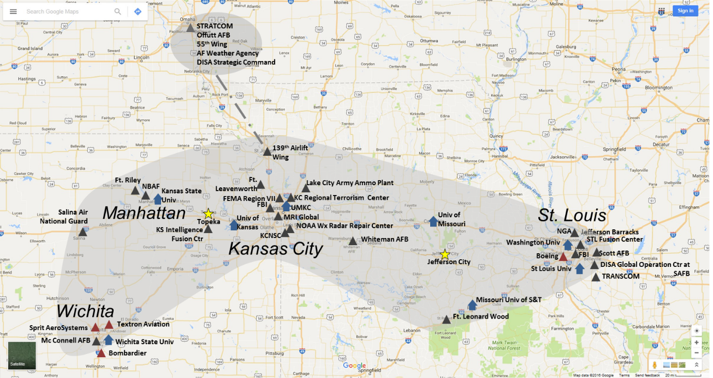
MISSION
Brand the region as a National Security strength and home for new national security missions, educate federal legislators on the value of the Crossroads, and share best practices to enable members of the Crossroads to be agile and resilient.

Slide 3













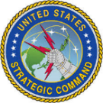



UNIQUE NATIONAL SECURITY INSTALLATIONS
National Bio and Agro-Defense Facility (NBAF) – KS
Department of Energy’s Kansas City
National Security Campus (KCNSC) - MO
National Geospatial-Intelligence Agency (NGA) – MO
National Bio and Agro-Defense Facility (NBAF) - KS
National Bio and Agro-Defense Facility (NBAF) - KS
National Bio and Agro-Defense Facility (NBAF) - KS
NBAF will be a state-of-the-art biocontainment laboratory for the study of diseases that threaten both America’s animal agricultural industry and public health. DHS S&T is building the facility to standards that fulfill the mission needs of the U.S. Department of Agriculture (USDA) which will own, manage and operate the NBAF once construction and commissioning activities are complete. The NBAF will strengthen our nation’s ability to conduct research, develop vaccines, diagnose emerging diseases, and train veterinarians.
KCNSC is managed by Honeywell and has more than 4,500 employees. KCNSC is one of eight sites that comprise the NNSA’s national security enterprise. Our primary mission is manufacturing 85 percent of non-nuclear components that go into the nuclear stockpile. We develop advanced solutions for complex national security issues, from prototype simulations to production to quality testing. KCNSC also provides field-ready solutions for other government agencies and businesses for the intelligence and defense communities through a 330K sf SCIF.
The NGA’s West Campus, located in St. Louis is a unique combination of intelligence agency and combat support agency. It is the world leader in timely, relevant, accurate and actionable GEOINT. NGA enables the U.S. intelligence community and the Department of Defense (DOD) to fulfill the president’s national security priorities to protect the nation. NGA also anticipates its partners’ future needs and advances the GEOINT discipline to meet them.
USSSTRATCOM – NE
USTRANSCOM – IL
US Army’s Combined Arms Center (CAC) - KS
Defense Information Systems Agency – NE
National Bio and Agro-Defense Facility (NBAF) - KS
National Bio and Agro-Defense Facility (NBAF) - KS
National Bio and Agro-Defense Facility (NBAF) - KS
National Bio and Agro-Defense Facility (NBAF) - KS
USSTRATCOM deters strategic attack and employs forces, as directed, to guarantee the security of our nation and our allies. STRATCOM mission areas include Strategic Deterrence, Nuclear Operations, Cyberspace Operations, Integrated Missile Defense, Intelligence, Surveillance, and Reconnaissance, Information Operations, and Combating Weapons of Mass Destruction to meet both deterrent and decisive national security objectives.
USTRANSCOM is the transportation provider for the DoD. TRANSCOM sustains the force, operates the Joint Deployment and Distribution Enterprise, and set the globe for logistics. TRANSCOM establishes an equilibrium between the capability and capacity through component commands :Military Surface Deployment and Distribution, Military Sealift, and Air Mobility, and the Joint Enabling Capabilities Command.
CAC mission is divided between preparing the Army for the Global War on Terrorism and transforming it to meet future threats. CAC develops and integrates Army leader development, doctrine, education, lessons learned, training, and proponent responsibilities to support mission command and prepare the Army to conduct unified land operations in a joint, inter-agency, inter-governmental, multinational environment.
The mission of the field office is to be the combat support agency's forward representative to the Combatant Commander. Provides direct support for net-centric solutions across the Global Information Grid in United States Strategic Command's (USSTRATCOM) operational mission areas of responsibility.

Slide 4
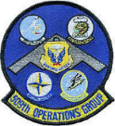




MAJOR MILITARY INSTALLATIONS
Whiteman AFB – MO
Offutt AFB – NE
Fort Riley – KS
National Bio and Agro-Defense Facility (NBAF) - KS
National Bio and Agro-Defense Facility (NBAF) - KS
National Bio and Agro-Defense Facility (NBAF) - KS
A joint-service base that is host to the Air Force’s 509th Bomb Wing (AFGSC) and the 131st Bomb Wing (MO National Guard), operators of the nation’s only B-2 Spirit Bombers; the 442nd Fighter Wing (AFRC) flying the A-10 Thunderbolt II; the 20th Attack Squadron, 432nd Wing (ACC) operating MQ-9 Reapers; 1-135th Assault Helicopter BN (MO National Guard)
Offutt Air Force Base is the host station for the 55th Wing (55 WG), the largest wing of the United States Air Force's Air Combat Command. Additionally, the base is home to many significant associate units, including US Strategic Command Headquarters, the Air Force Weather Agency, the Omaha operating location of the Defense Finance and Accounting Service, and many others.
"Home of the Big Red One" (1st Infantry Division), is known for its excellent training, abundant recreational opportunities, rich history, and tremendous relations with surrounding communities.
McConnell AFB – KS
National Bio and Agro-Defense Facility (NBAF) - KS
McConnell Air Force Base is the home of the 22nd Air Refueling Wing that delivers total force mission ready Airmen and KC 46 Pegasus mobility to combatant commanders through robust installation support.
Fort Leonard Wood – MO
Scott AFB – IL
National Bio and Agro-Defense Facility (NBAF) - KS
National Bio and Agro-Defense Facility (NBAF) - KS
Home to the Maneuver Support Center of Excellence (MSCoE), Fort Leonard Wood trains and educates service members and develops doctrine and capabilities for the Training and Doctrine Command’s U.S. Army Chemical, Biological, Radiological, and Nuclear School, U.S. Army Engineer School, U.S. Army Military Police School, and the U.S. Army Prime Power School.
Home to USTRANSCOM, the Air Force Mobility Command, DISA Global Operations Command, Military Surface Deployment and Distribution Command, 18th Air Force, the Air Force Network Integration Center, and the 375th Air Mobility Wing, which is responsible for DV airlift for senior leaders and flies aeromedical evacuation missions for wounded warriors and medical patients, and provides the nation with air refueling capabilities.
Fort Leavenworth – KS
National Bio and Agro-Defense Facility (NBAF) - KS
The Garrison command team and staff also conduct mission support to the senior commander of the Combined Arms Center. Our mission is to deliver diverse and quality services, as extraordinary as the people we serve, in fostering a sense of belonging.

Slide 5
OBJECTIVES
Attraction of new federal mission
Retention & expansion of existing federal national security missions
Improve workforce attraction / retention and drive economic growth
Increase regional federal agency interaction to speed problem solving & save federal budget dollars
Improve veteran hiring

Slide 6
USE CASE
CUSTOMER VALUE
Non-Profits
Academia
Industry
VC / PE
Agility
  Fluctuations in cleared workforce between Midwest federal agencies
  Midwest employees want to stay in Midwest – could transfer between agencies/facilities as budgets increase/decrease
Unlock Value
  Share process best practices
    Hiring veterans
    Cyber
    Retention
    Recruiting to the federal sector
    Clearances
    Supply Chain
St Louis Ptr
Wichita Chamber
KCADC
Manhattan Chamber
Crossroad/ Mission Growth
MO Military Advocate
KS Military Advocate
Crossroad Support/Promote/Benefit
Convener – Neutral
Targeted Crossroads Federal Members
DISA / Others
STRATCOM
NNSA - KCNSC
NGIA-West
DHS NBAF
FBI
Whiteman AFB
Ft. Leonard / Ft. Riley
McConnell AFB
Ft. Leavenworth
Fusion Center
Scott AFB
Federal Mission Awareness / Collaboration / Efficiency

Slide 7
BENEFITS
StratCom
KCNSC
StratCom
KCNSC
ISLANDS
ONE-TO-ONE
Difficult to scale
Missed Opportunities
Hugely Labor Intensive
Low Returns on Effort / Constrained
Costly
Yesterday’s Approach
NETWORKS
ONE-TO-MANY
Scalable
Best Practices / Cost Savings
SPP / Supplier Reach back
Agile / Responsive
The Place to Be / Differentiated
Breadth / Depth of Labor
Positioned for Tomorrow
OGA
OGA
Other Federal
Other Federal
National Security Crossroads
Universities
Universities
NBAF
Regional Suppliers
NBAF
Regional Suppliers

Slide 8
WHAT THE CROSSROADS IS
WHAT THE CROSSROADS IS NOT
Focus on federal mission growth
A regional brand to educate state & federal legislators
Facilitate workforce initiatives / growth
Facilitate collaboration throughout the Crossroads on appropriate topics
Enable local & state to use brand and data to support local & state efforts
Identify federal RFP opportunities
Political Lobbying
Job Boards
A replacement for state military direction
Local / city economic development strategy
RFP coordination / response

Slide 9
TEAM MEMBERS TO DATE
Kansas City National Security Campus
Kansas City Area Development Council
St. Louis Economic Development Partnership
Manhattan Chamber
Greater Wichita Partnership
Missouri Partnership
Missouri Chamber of Commerce and Industry
Kansas Department of Commerce
Missouri Economic Development
Greater Kansas City Chamber
Kansas Governor’s Military Council
Missouri Military Advocate
St. Louis Regional Chamber

Slide 10
HOW YOU CAN HELP
Inform your federal legislator of importance
Point of contact for best practice sharing

